Slide 1
Employee Management System (EMS)
Developed by Team V18
Review 1- Presentation
NAME OF GROUP MEMBER : --
Ujjwal Kumar (Leader).
Vikash Kumar
Ritik Kumar

Slide 2
Index :
Project Overview
Project Structure
Database schema
MySQL Table
DATA-Based DESIGN File based storage
Console UI & Aesthetics
Preview Result
Challenges Faced
Future Enhancements
Conclusion

Slide 3
Project Overview
Purpose: Manage employee records using Java.
Technology: Java,File Handling (Text Files), OOP principles.
Interface: Console-based user interface.
FEATURES :--
MainMenu - Displays main options to user.
EmployManagementSystem - Main class, controls app flow.
Add Employee - Adds new employee (writes to file).
Show Employee - Displays employee details from file.
Remove Employee - Deletes employee file.
Update Employee - Updates employee info in file.
EmployeeDetail - Collects employee input data.

Slide 4
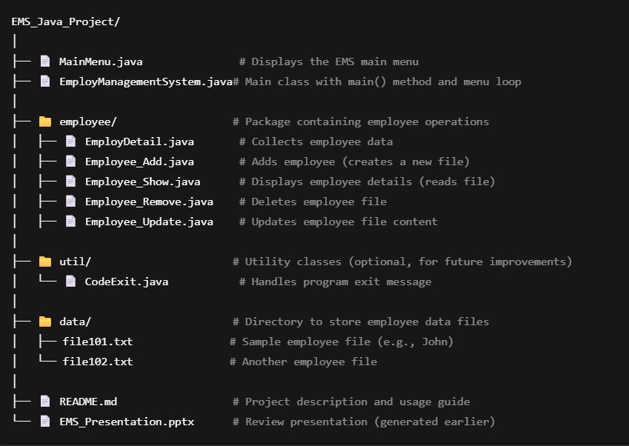
Project Structure
.

Slide 5
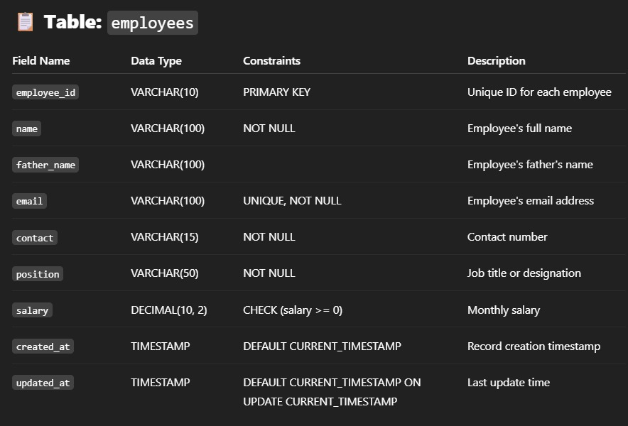
DATABASE SCHEMA

Slide 6
MySQL Table
employee_management_system;
CREATE TABLE IF NOT EXISTS employees (
employee_id VARCHAR(10) PRIMARY KEY,
name VARCHAR(100) NOT NULL,
father_name VARCHAR(100),
email VARCHAR(100) NOT NULL UNIQUE,
contact VARCHAR(15) NOT NULL,
position VARCHAR(50) NOT NULL,
salary DECIMAL(10, 2) CHECK (salary >= 0),
created_at TIMESTAMP DEFAULT CURRENT_TIMESTAMP,
updated_at TIMESTAMP DEFAULT CURRENT_TIMESTAMP ON UPDATE CURRENT_TIMESTAMP
);

Slide 7
DATA-Based DESIGN File based storage
Each employee record is stored in a separate text file:
Format: file<ID>.txt
Example contents:
Employee ID: 101
Name: John Doe
Contact: 1234567890
Position: Developer
Salary: 50,000

Slide 8
Console UI & Aesthetics
Text-based menu system.
Clear navigation and prompts.
Input gathered using Scanner.
Future Scope: Upgrade to GUI using JavaFX/Swing.

Slide 9
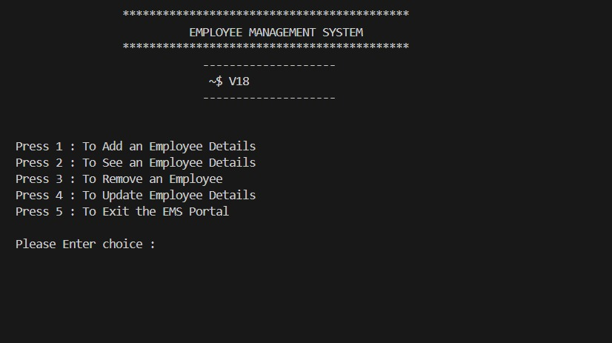
PREVIEW RESULT

Slide 10
Challenges Faced
Handled duplicate file creation using File.exists().
Basic try-catch blocks used for file operations.
Input validation and exception handling.
Bug fixed: Incorrect file deletion logic.

Slide 11
Future Enhancements
Use a centralized database (MySQL or SQLite).
Implement JDBC for database operations.
Add GUI interface using JavaFX.
Include admin login system.
Generate reports (PDF/Excel).

Slide 12
Conclusion
Successfully built a Java-based Employee Management System using JDBC and MySQL.
Implemented CRUD operations with clean separation of logic using Model and DAO classes.
Designed a clear, responsive console UI with proper prompts, validations, and error handling.
Ensured accessibility through keyboard navigation and screen-reader friendly design.
Project structure is modular and scalable, ready for future GUI or web-based upgrades.
Demonstrates strong grasp of Java OOP, database connectivity, and UI/UX principles.

Slide 13
Thank You
Developed by Team V18
Employee Management System - Java Project

